Slide 1

Peaceful Paradise
Project presentation

Slide 2
Booking Process
Step 1
Step 2
Step 3
Step 4
Step 5
Search a free room by your needs
Select the type of the room
Pick a service type
Provide your personal data
Finalize the reservation

Slide 3

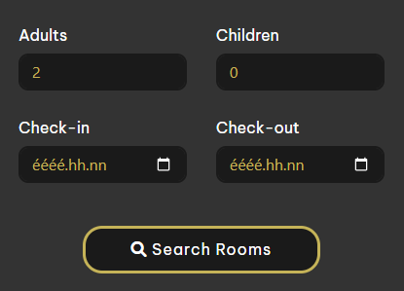
Provide your needs
Number of guests
Check-in date
Check-out date
Our search form

Slide 4

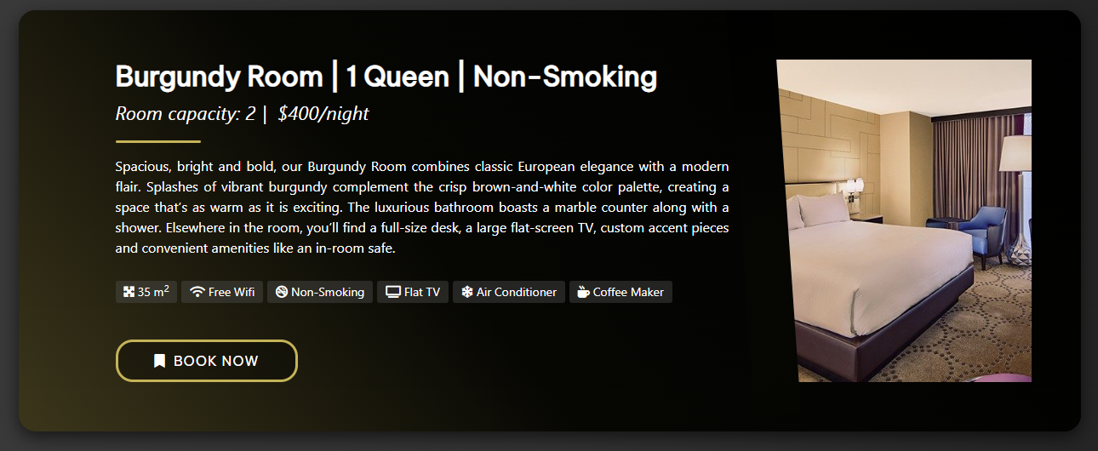
Pick a room
Suitable rooms
Room traits
Description
Images

Slide 5

Room details / Service type
More details
Pick a service type
Prices

Slide 6
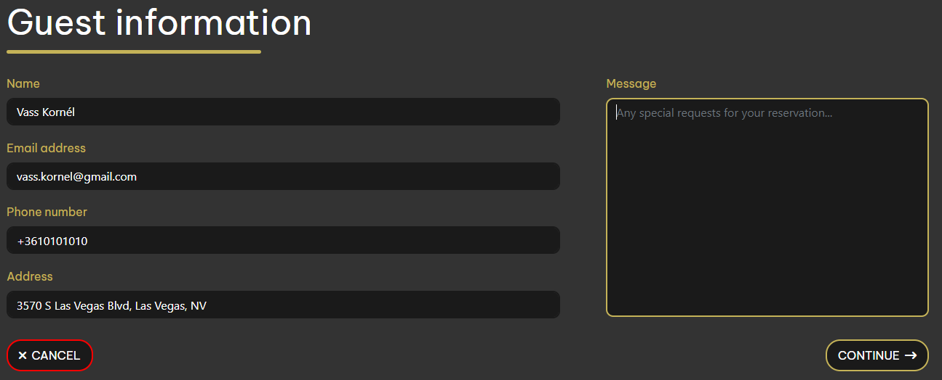
User informatins
Contact informations
Special requests

Slide 7


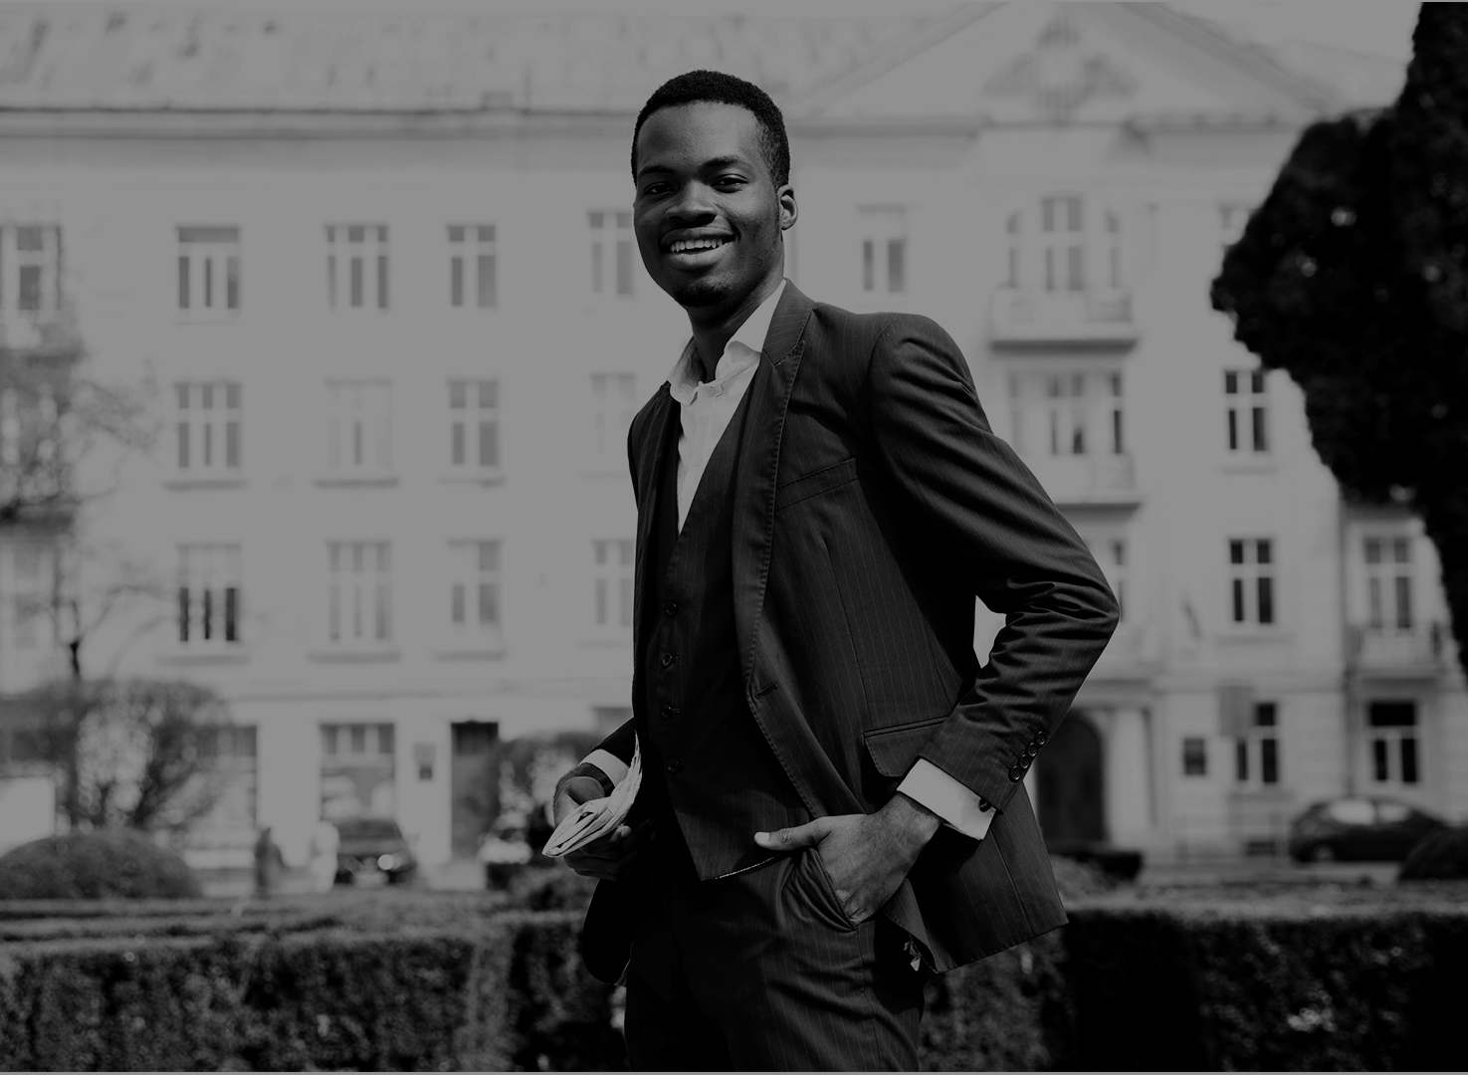
Our Team
Gábor Roncz
Reservation System
API Requests
Dávid Kálmán
Kornél Vass
Design
Sign-in, Email
Reception App
Database

Slide 8




Our discount system
Gold
Platinum
Diamond
3 reservations
5% discount
6 reservations
10% discount
9 reservations
15% discount

Slide 9

Login
Registration
Email or username
Password
Forgot password
Name
Email
Password
Confirmation

Slide 10

Check-in
Check-out
Select a client
Validate their data
Arrange payment
Select a guest
Review their check-out date
Check their consumptions
Discuss remaining costs

Slide 11

Thank you for your time!
Made by:
Dávid Kálmán
Gábor Roncz
Kornél Vass

